Slide 1
Digital Image Processing Laboratory
Electronics and Electrical Communication Engineering
Indian Institute of Technology, Kharagpur
2020-21

Slide 2
Experiments
Read and write an image
Contrast Enhancement
Spatial filtering
Frequency filtering
Image segmentation

Slide 3
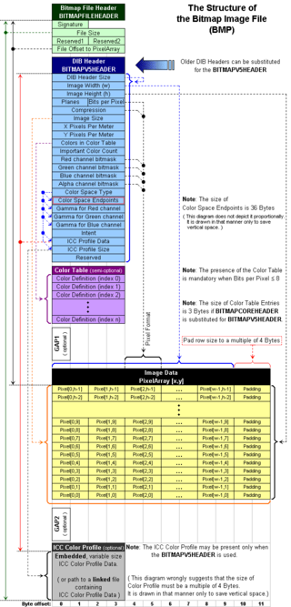
Experiment 1.
Read and write an image
Read and write a bitmap format image.
Header information
Image Data
RGB to grayscale conversion
Flipping of an image

Slide 4
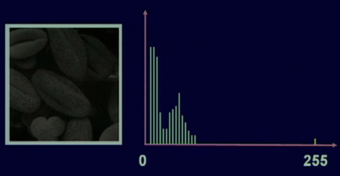
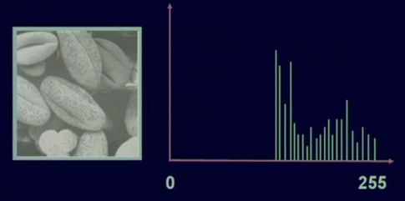
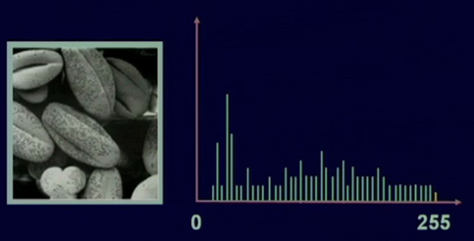
Experiment 2.
Contrast Enhancement
Histogram equalization
Histogram matching
Dark Image
Bright Image
Equalized Image

Slide 5


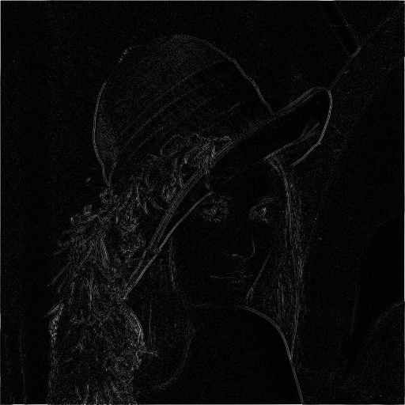
Experiment 3.
Spatial filtering :- filtering in spatial domain
Noise filtering
Averaging filter
Median filter
Gaussian filter
Edge Detection
Sobel filter
Prewitt filter
Laplacian filter
Input Image
Averaging filter
Laplacian filtered

Slide 6
Experiment 4.
Frequency filtering :- filtering in frequency domain
Low Pass filtering
High pass filtering
Ideal filters
Gaussian filter
Butterworth filter
Input Image
Forward
Transformation
Processing
Inverse Transformation
Output Image
Filters

Slide 7
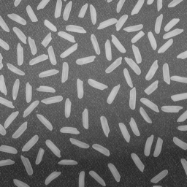
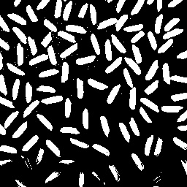
Experiment 5.
Image segmentation :- partition the image into segments.
Connected component labelling
Otsu thresholding
Region Growing
Input Image
Output Image

Slide 8
Evaluation Criterion (Tentative)
Experiments:- 60 %
Code 20%
Output 10%
Viva 20%
Report 10%
Two comprehensive Viva or Mini Project - 40%

Slide 9
Submissions:
https://www.usebackpack.com/iitkgp/courses/3c95f6
Joining Code: e39bd5
Submission should be done before the deadline.
Submission should contain a single zipped folder
Report (in pdf format, containing an introduction, algorithm, output results, analysis)
Code (A well-documented self-explanatory single C/CPP file)
· Input and output images
· Readme file (containing details about how to execute code)

